Slide 1


Skynet Project
Big Data Hackers
21 May 2015

Slide 2
Who is Think Big?
Think Big helps organizations unlock the value of big data through data science and engineering services

Slide 3
Skynet Use Case
Jun | Jul | Aug | Sep | Oct | Nov | Dec | Jan | Feb | Mar | Apr | May
 | Jul | Aug | Sep | Oct | Nov | Dec | Jan | Feb | Mar | Apr | May
Phase 1: Finalize data sources and use cases + sign off.
Identify aircraft type certification candidates
Deploy in house big data platform
Build out infrastructure
Transponder: Add predictive analytics on already certified transponders
Transponder: Take advantage of empty field and introduce into data lake solution
Ground operations: predict aircraft delays
Ground operations: predict spare parts stock needs

Slide 4





Target Architecture
0 - Data Sources
1 - Ingest data
2 - Process data
3 - Publish information
Business Insights Platform
Transponder signals
Reception logic
Custom business logic and on the fly analytics
Tailored data publication
Transponders
Aircraft type candidates for certification
FAA Aircraft registry
KBOS
Flight History
HDFS
Commodity servers / Cloud

Slide 5
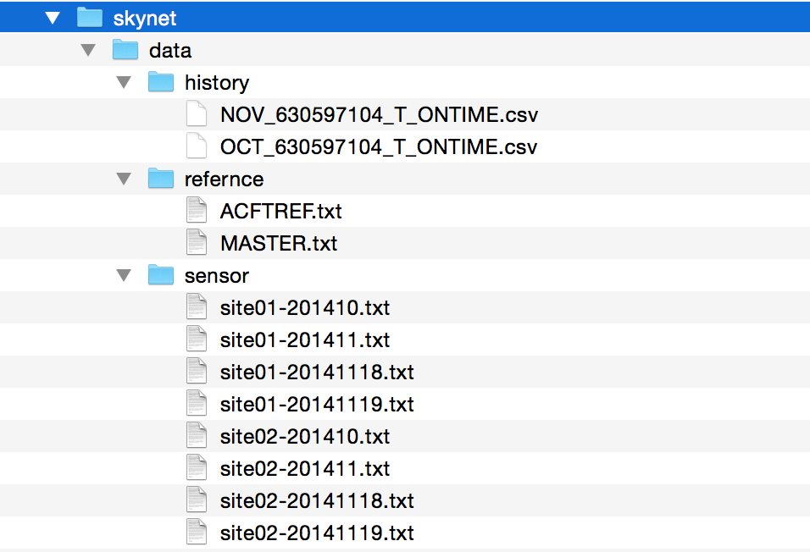
Ingest Data

Slide 6
Store data in Hadoop Cluster
% hadoop fs -put skynet /

Slide 7
Reference Flight History Data in Hive Table
hive>create external table history ( date string, unique_carrier string, airline_id string, carrier string, tail_num string, flight_num string, origin string, dest string) row format delimited fields terminated by "," location "/skynet/data/history/";
hive> select * from history limit 10; OK "FL_DATE" "UNIQUE_CARRIER" "AIRLINE_ID" "CARRIER" "TAIL_NUM" "FL_NUM" "ORIGIN” 2014-11-01 "AA" 19805 "AA" "N3GMAA" "25" "BOS" "Boston 2014-11-01 "AA" 19805 "AA" "N639AA" "84" "BOS" "Boston 2014-11-01 "AA" 19805 "AA" "N3LTAA" "143" "BOS" "Boston

Slide 8
Extract Flight Hex Id From Sensor Data with Java API
hive> select * from sensor limit 10; A08209 A08EC4 A1B247 A251FC A2AB64 A346D0 A42A0B A44F0D

Slide 9
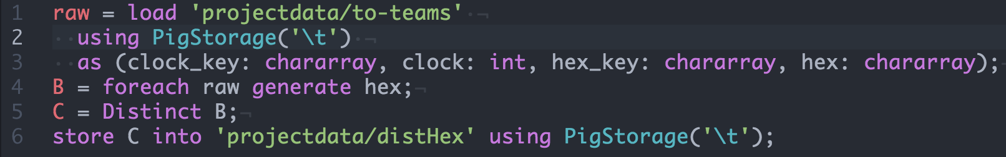
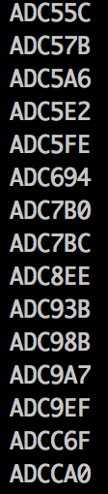
Distinct Sensor Data (Another approach)

Slide 10
Create Hive Tables for Aircraft Ref Data
hive> select * from sensor limit 10; A08209 A08EC4 A1B247 A251FC A2AB64 A346D0 A42A0B A44F0D

